Slide 1
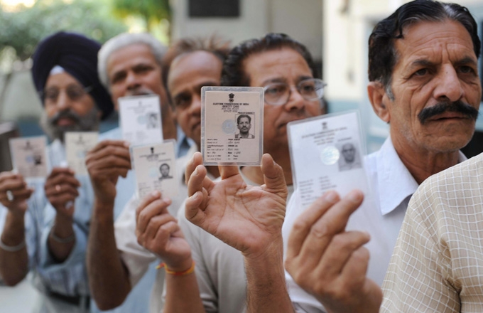

THE Elections
BY MANAV, ANISH, SARVESH, DIYA AND RISHABH

Slide 2
CONSTITUENCIES
For elections, the country is divided into regions called “constituencies”. These regions are divided based on population; each region roughly has the same number of people. Any number of candidates can stand for elections from a constituency. India currently has 543 constituencies.

Slide 3
THE ELECTIONS
Candidates can be part of groups (parties) or can contest as independent candidates. The candidate who receives the maximum votes becomes the Member of Parliament (MP) from that constituency. Any citizen above the age of 18 years can participate in the electoral process. The elections were conducted using the secret ballot, but we now use electronic voting machines (EVMs).

Slide 4
THE NEW GOVERNMENT
The party or individual which gets an absolute majority (more than half the seats in the Parliament) forms the government. Currently, a party would need 272 or more seats to win the elections. If no party gets over half of the seats, parties may join to form a coalition government..

Slide 5
QUESTION TIME
WHAT ARE THE NUMBER OF CONSTITUENCIES IN INDIA?
543
WHAT IS AN ABSOLUTE MAJORITY?
WHEN THE PARTY GETS MORE THAN 50% OF THE SEATS IN THE PARLIAMENT, IT IS CALLED AN ABSOLUTE MAJORITY
WHO IS THE CURRENT CHIEF ELECTION COMMISSIONER OF INDIA?
RAJIV KUMAR

Slide 6
THANK YOU

